Slide 1





RECTANGULAR
MICROSTRIP ANTENNA CALUCULATIONS
Calculation of the Width Calculation of the Effective Dielectric Constant
Calculation of actual length of the patch
Following parameters are used f₀ is the Resonance Frequency, W is the Width of the Patch, L is the Length of the Patch h is the thickness, ε_{r} is the relative Permittivity of the dielectric substrate c is the Speed of light: 3 x 10⁸

Slide 2
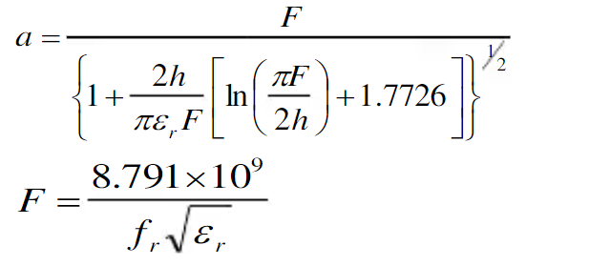
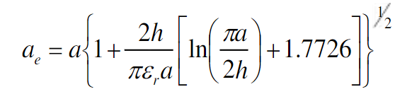
CIRCULAR
MICROSTRIP ANTENNA CALUCULATIONS
a = Radius of the patch
ae = effective Radius of the patch

Slide 3
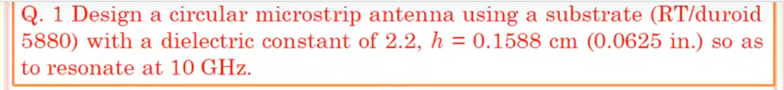

Slide 4
Methods of Analysis
The MSA generally has a two-dimensional radiating patch on a thin dielectric substrate and therefore may be categorized as a two-dimensional planar component for analysis purposes. The analysis methods for MSAs can be broadly divided into two groups.
In the first group, the methods are based on equivalent magnetic current distribution around the patch edges (similar to slot antennas).
There are three popular analytical techniques:
• The transmission line model;
• The cavity model;
• The multi-port network method (MNM).
In the second group, the methods are based on the electric current distribution on the patch conductor and the ground plane (similar to dipole antennas, used in conjunction with full-wave simulation/numerical analysis methods). Some of the numerical methods for analyzing MSAs are listed as follows:
• The method of moments (MoM);
• The finite-element method (FEM);
• The spectral domain technique (SDT);
• The finite-difference time-domain (FDTD) method.

